Slide 1

PHOTOGRAPHIC ESSAY: WAITING FOR THE SKY TO FALL
Youth Unemployment in Africa – A Visual Paradox
Africa’s youth are the most educated and most unemployed generation in history.

Slide 2
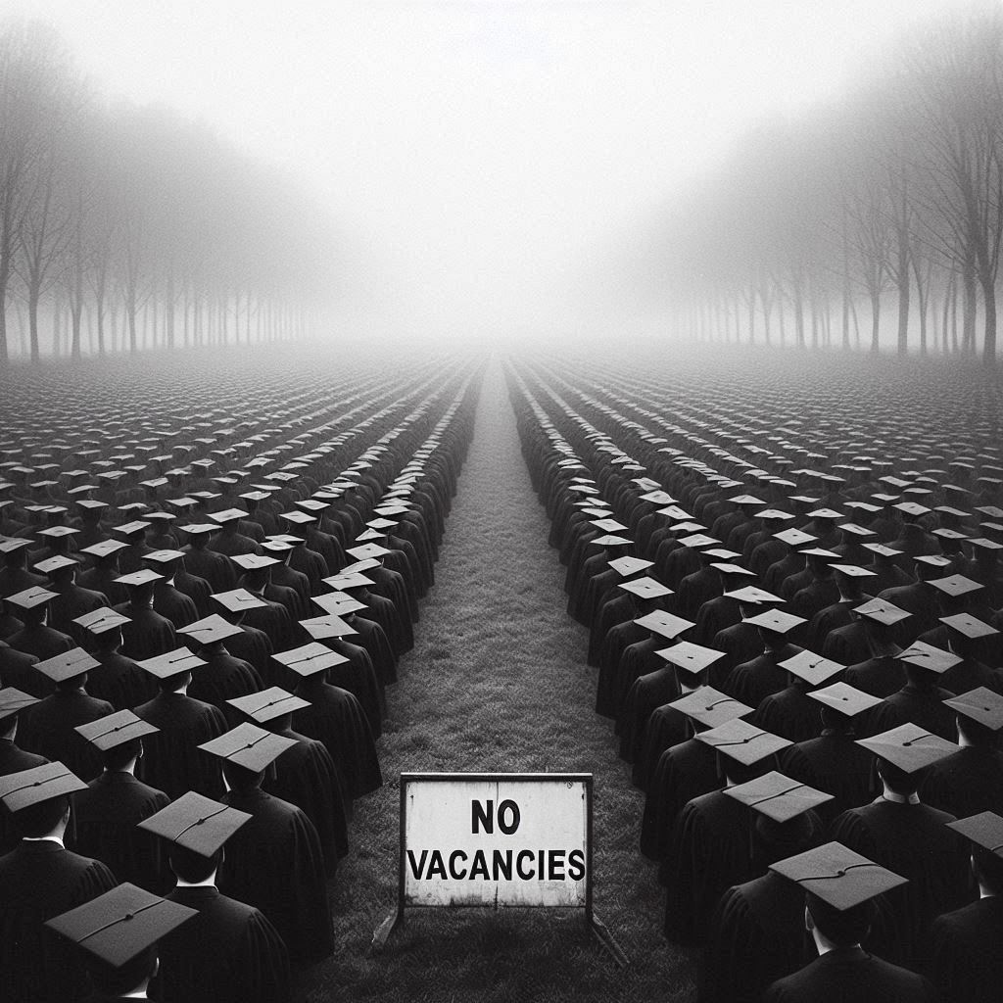

THE QUEUE TO NOWHERE
12 million enter the job market yearly. 75% will join the informal hustle.
In Lagos, it takes 3,000 applications to land one minimum-wage job.

Slide 3


THE ALGORITHM OF THE STREETS
‘Freelancer’ is just a fancy word for ‘survivor.’
The digital escape route: Ctrl + Alt + Delete your future here."

Slide 4

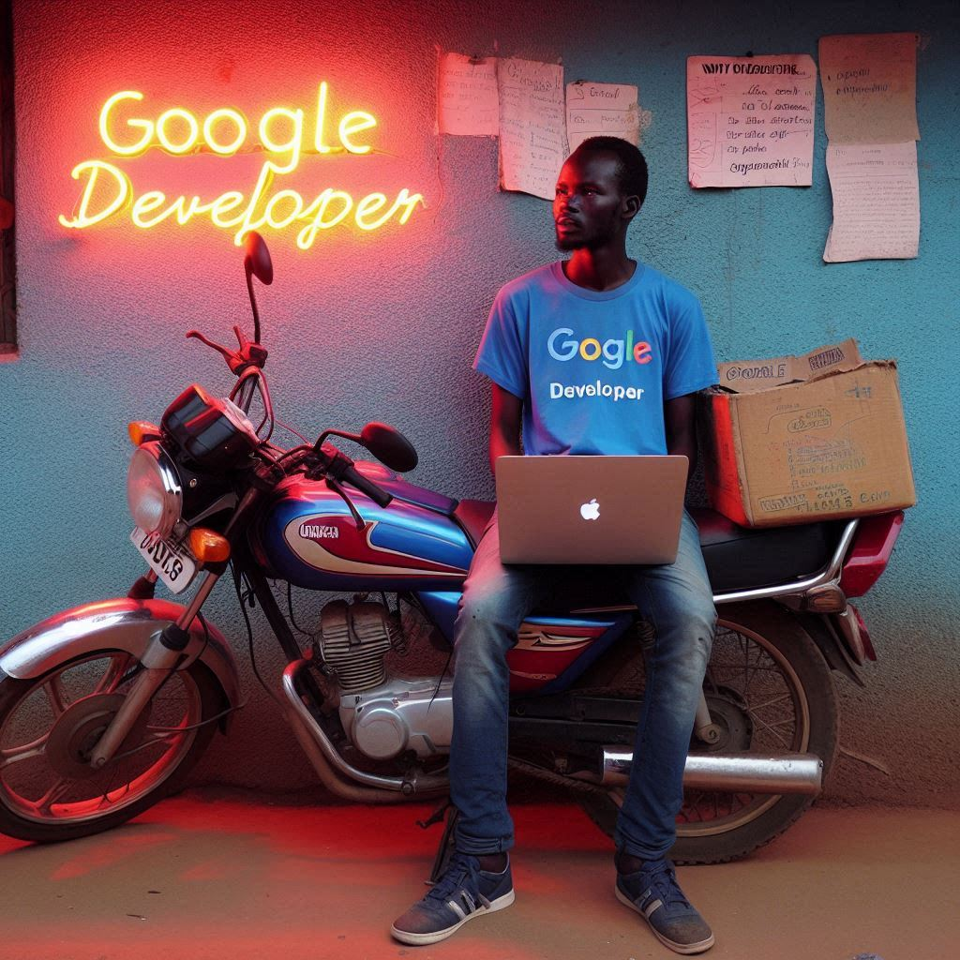
GHOSTS OF POTENTIAL
Education promised wings. The economy gave us matches.
Unemployment rate: 62%. Hustle rate: 100%.

Slide 5


THE SKY IS A LADDER
Silicon Savannah isn’t a place, it’s a mindset.
They told us the sky was falling. We’re building stairs from the rubble.

